Slide 1

Team Blood Moon Biographies
Michael (Mikko) Day and Ace Houston
SMAD 404/ 408 - Blood Moon
Ace Houston and Michael Daye
SMAD 404/408
2/10/25

Slide 2
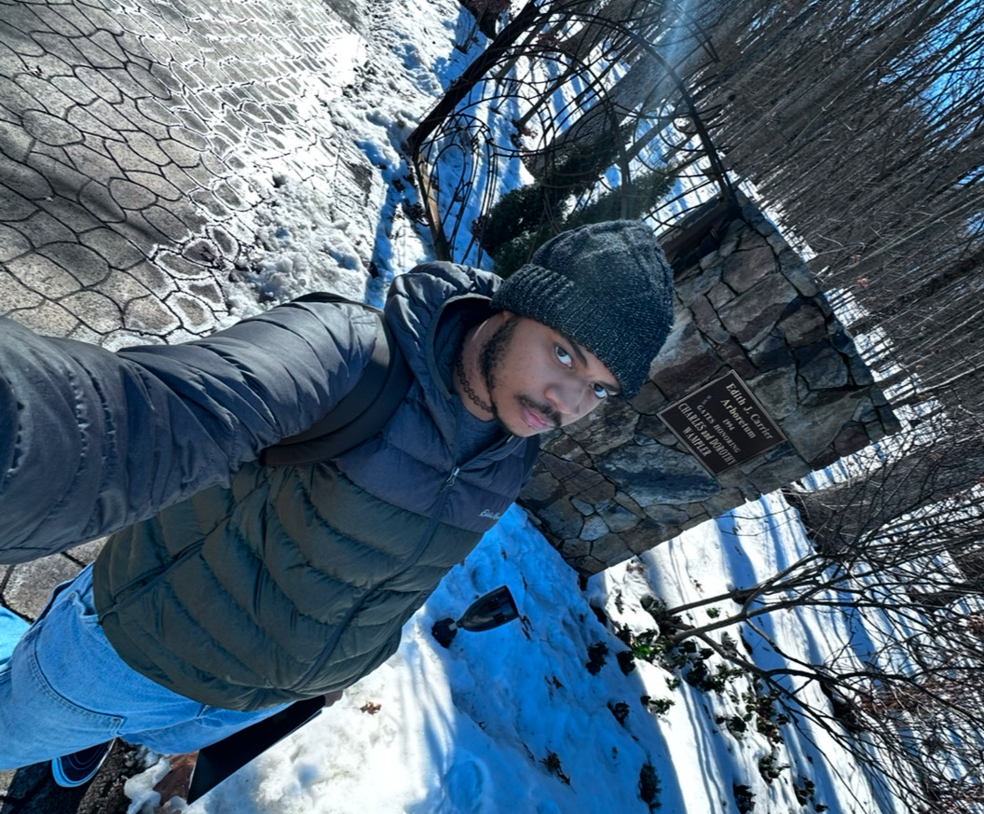
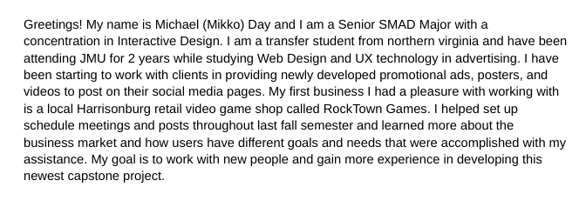
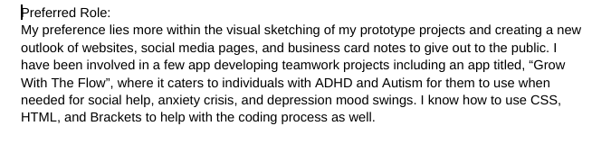
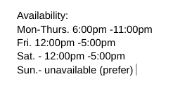
Michael (Mikko) Daye

Slide 3
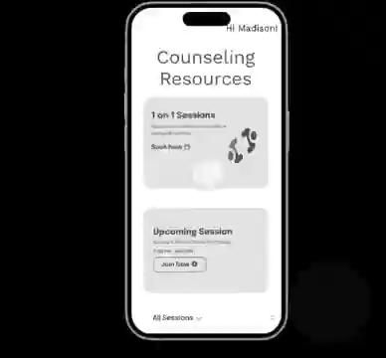

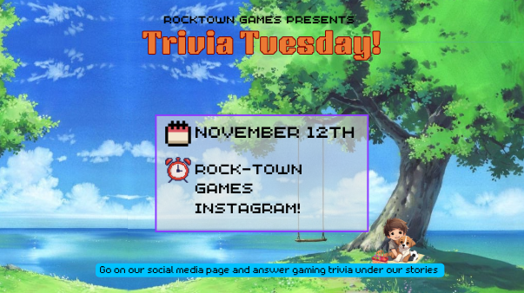

Visual Portfolio

Slide 4
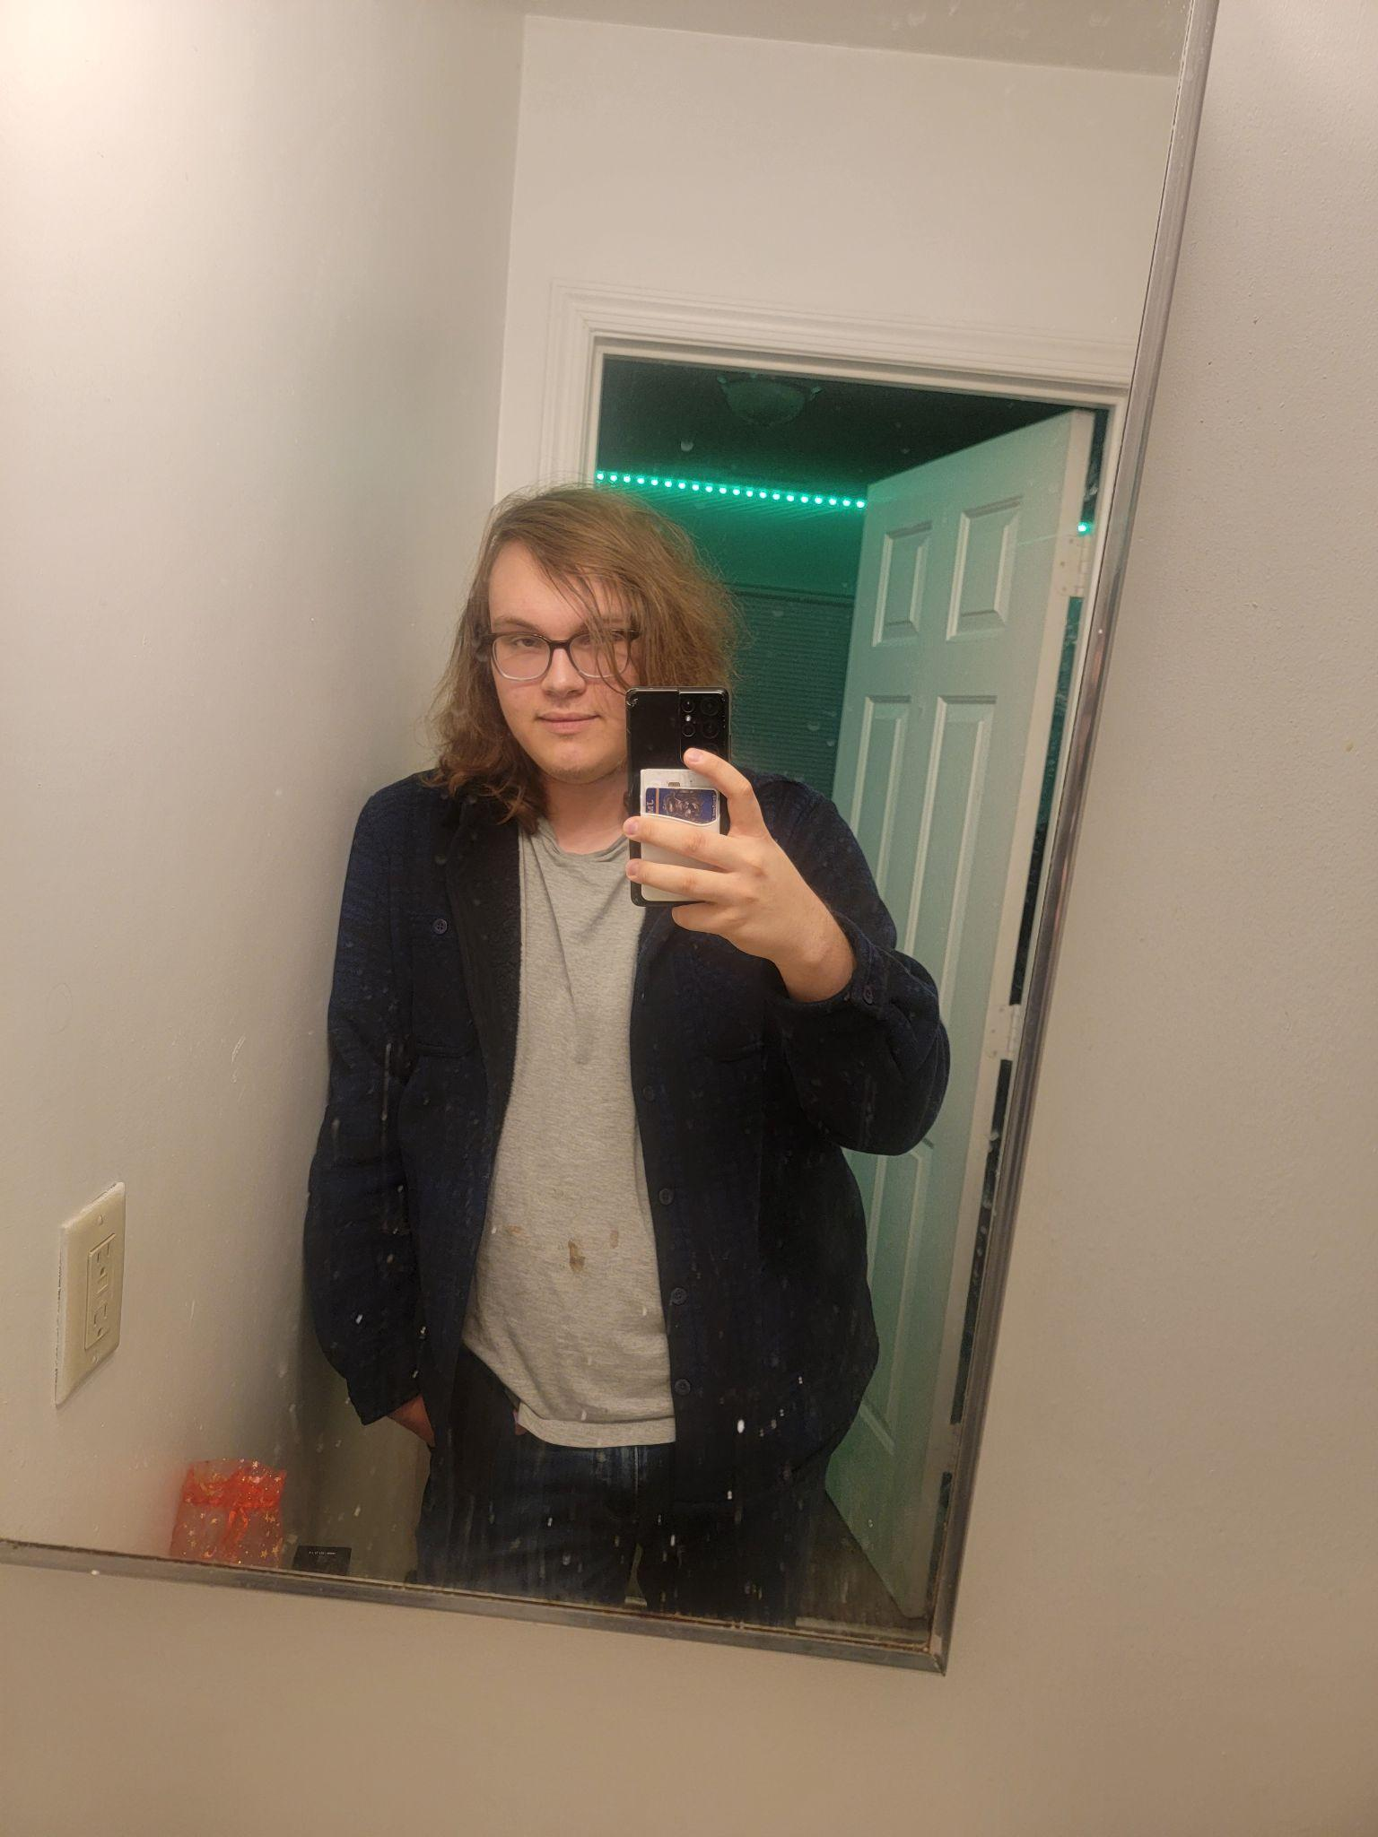
Ace Houston
Hey! My name is Ace Houston. I’m a 5th-year SMAD major at JMU with a concentration in Interactive Design. I’m most comfortable working with Adobe programs like Photoshop, Illustrator, Indesign, etc. I’m also proficient coding with HTML and CSS. I’m currently searching for more experience in my field, as well as jobs that will hire an entry-level web designer / front-end developer / user experience designer.
I also run a small, fairly-lucrative online art business with a focus on fantasy elements.
I want to use this capstone project to create a finished work that will help me grow in my selected fields, show off my skills to future employers, cement myself as exceptional in my areas of study.
Preferred Role:
I would prefer to be in charge of general web design layout, as well as integrating front-end
code into whatever finished product we create. I’m also fairly decent at making custom
art designs so I’m more than happy to add some flair to our finished product.
I’m familiar with: Adobe Photoshop, Indesign, Illustrate, XD, Figma, Canva, Miro, Microsoft products, Google products, Clip Studio Paint, HTML, and CSS. (And I’m learning javascript!)
Availability:
Mon: Not available
Tues, Thurs: 4 PM - 11 PM
Wed: 10 AM - 4 PM
Friday: 6 PM - 11 PM
Sat: All Day
Sun: 10 AM - 5 PM

Slide 5
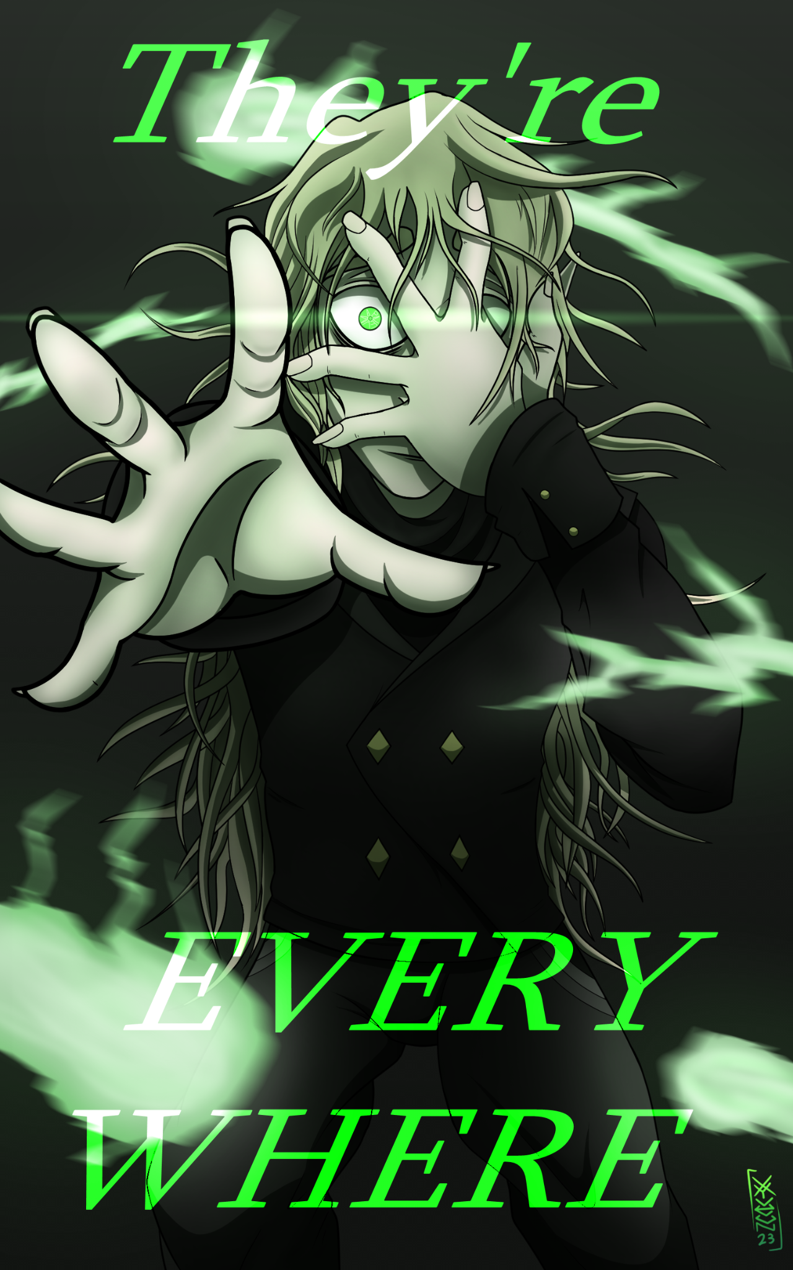
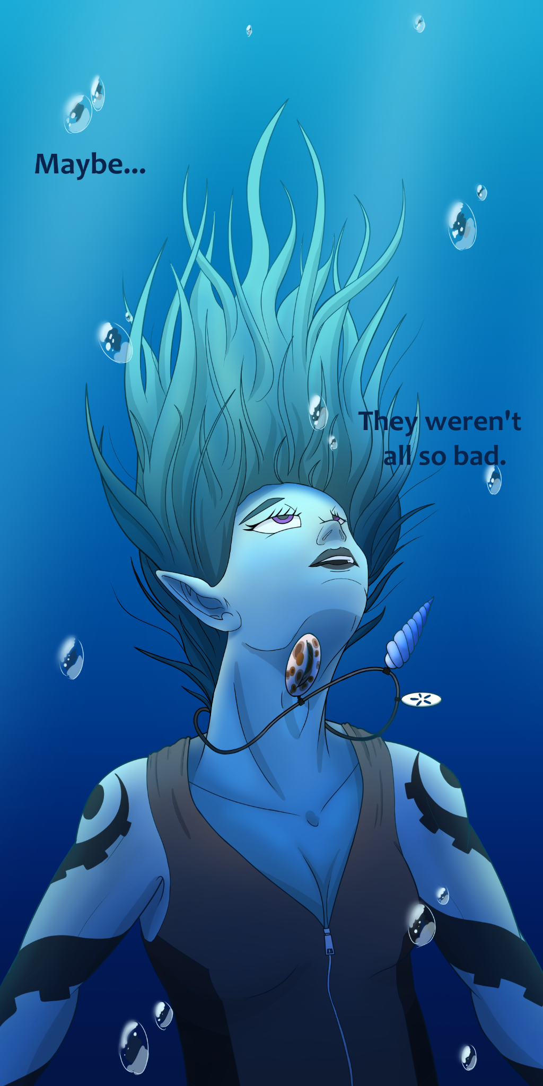
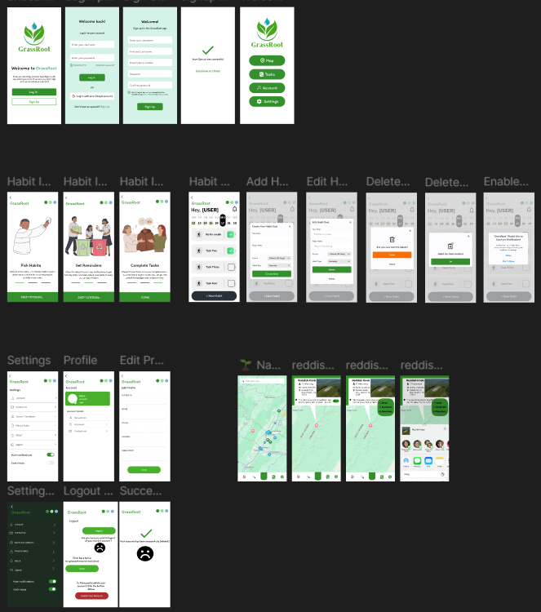
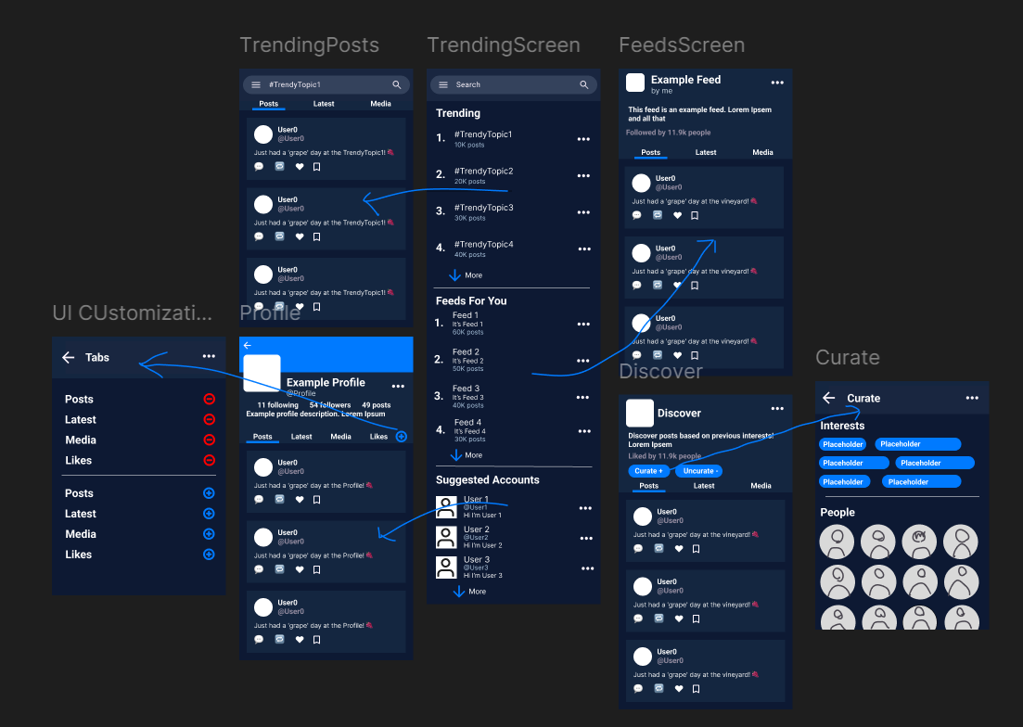
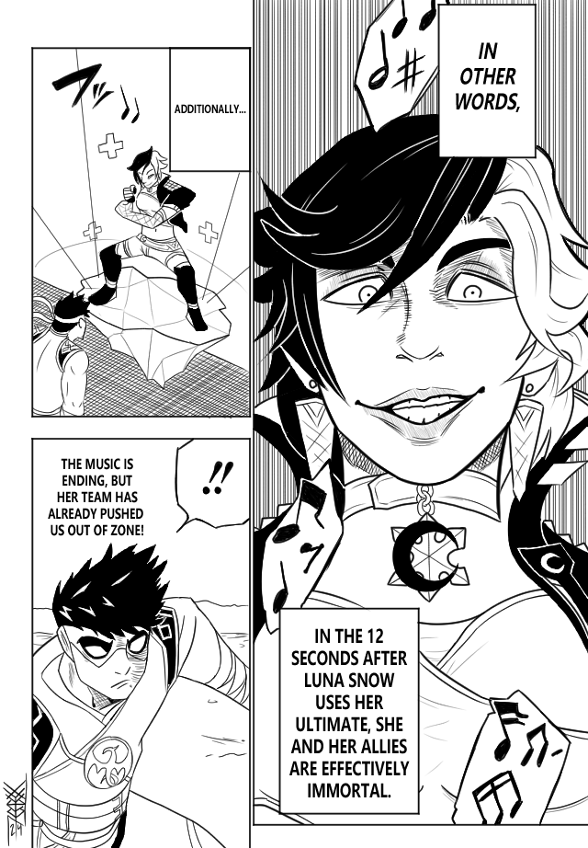
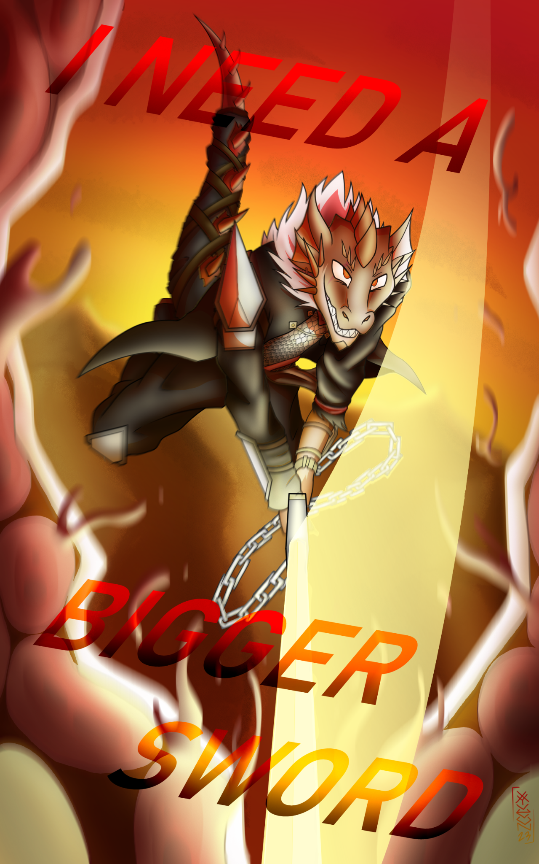
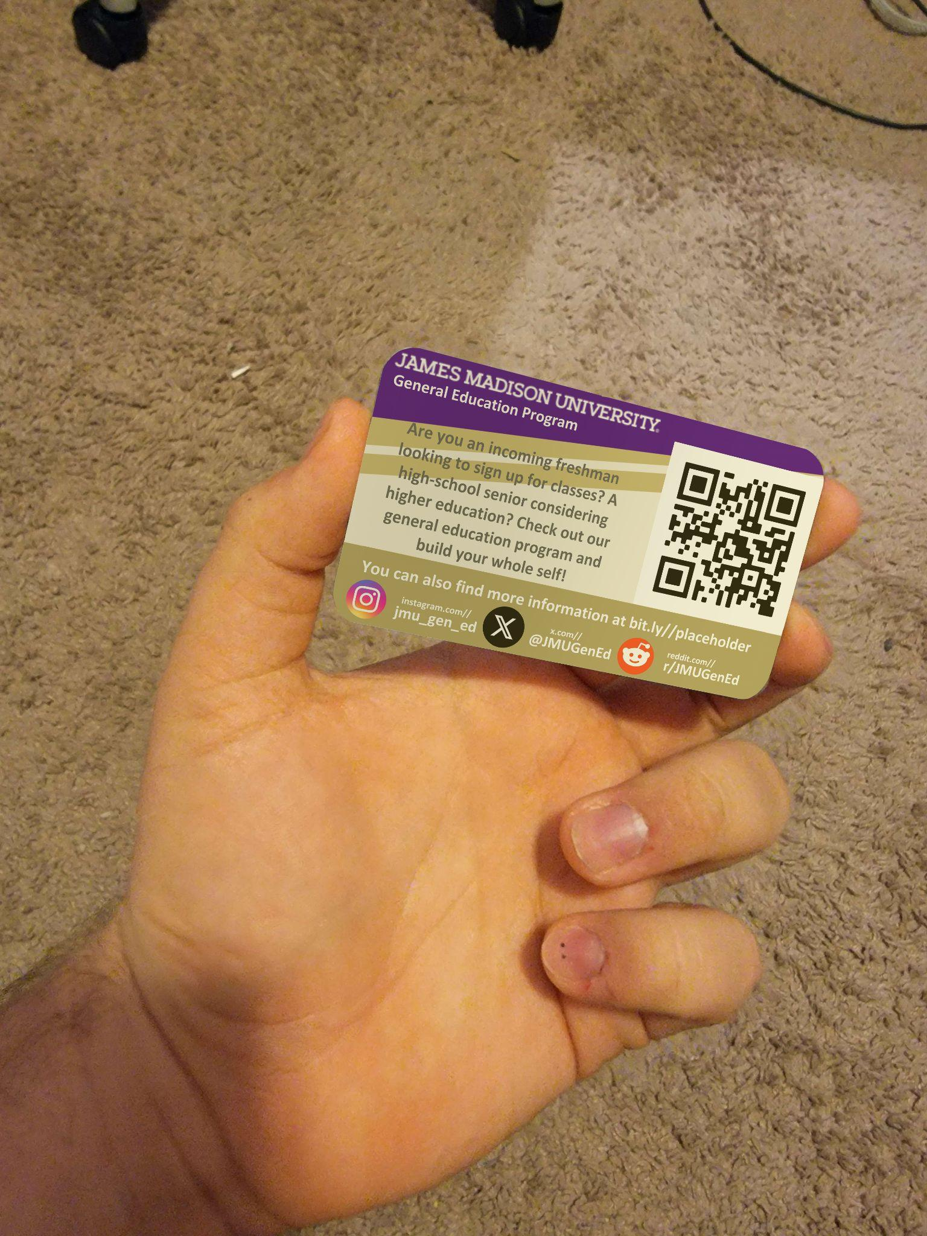
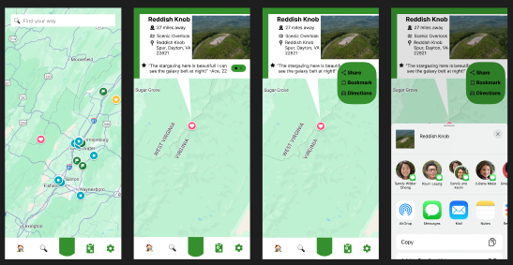
Visual Portfolio
PERSONAL ART DESIGN
UX / WEB DESIGN

Slide 6
THANK YOU!
We hope you wanna work with us!
Lines of Communications
540-395-7019
757-373-7636
Business Emails:
@dayemw@dukes.jmu.edu
@houstojt@dukes.jmu.edu

